Slide 1
Gamification Wizard
Alexander Willför, Aleksi Haavisto, Jaakko Antikainen, Teivo Hyvärinen

Slide 2
Use case
Students log in using their university credentials
Navigate through an interface with options to view available tasks, progress, and access help or tutorials
Completing tasks
Solve interactive tasks like crossword puzzles, drag-and-drop, and multiple-choice questions
Receive feedback and hints for incorrect answers
Progress metrics
Monitor individual performance via points
Earn collaboration points by completing tasks in groups
Unlock more puzzles as you complete tasks

Slide 3
Problem
Students often lack the motivation to fully engage with course material and lectures
Traditional lectures make it challenging to apply concepts in a real-world context
Students need more immediate feedback to guide learning progress
Students may struggle to understand gamification principles without practical application
Students may find collaborative tasks intimidating

Slide 4
Problem: use case metrics
Engagement measured through:
Time spent in the app
Number of completed puzzles
Goal: 90% of students complete at least 70% of tasks
Knowledge retention assessed through:
Improved quiz scores
Post-course feedback
Goal: Achieve a mininmum 20% improvement in post-test scores
Collaboration measured through:
Collaboration points
Task completion in groups
Goal: 90% of students earn required collaboration points

Slide 5
Concept overview
An interactive app that integrates gamified learning features such as:
Crossword puzzles, multiple-choice questions, and collaborative tasks
Progress tracking, point systems, and a guiding wizard for hints
Progression mechanics with unlockable levels
Collaboration points to incentivize group tasks
Admin tools for educators to create content and analyze student performance
Bridges the gap between theory and practice by making learning interactive, while aligning with course objectives

Slide 6
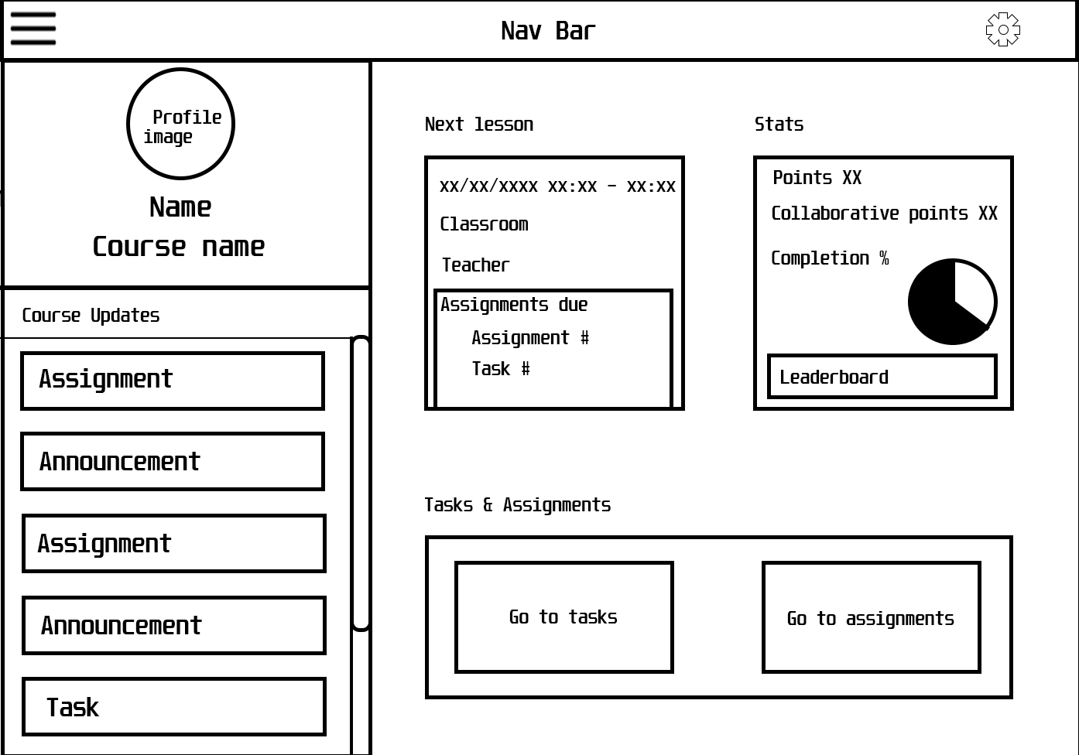
Wireframe: main menu

Slide 7
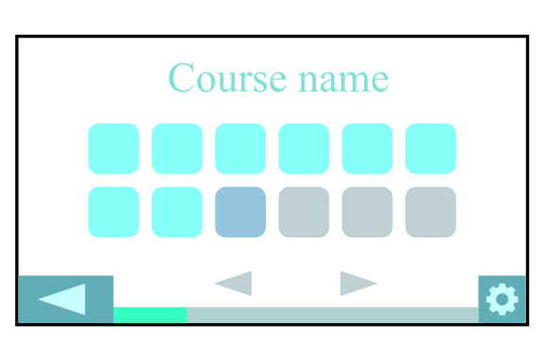
Image: Level select

Slide 8
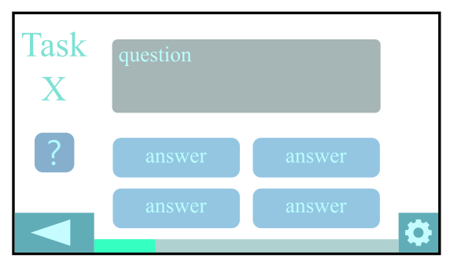
Image: Multiple choice

Slide 9
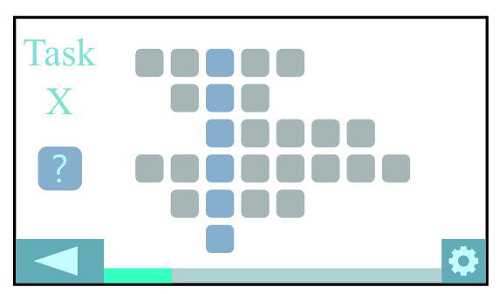
Image: Crossword

Slide 10
Pedagogical and motivational reasons
Key motivational elements:
Immediate Feedback: Students receive corrections and hints after incorrect answers
Progress Tracking: Unlockable levels provide a clear sense of achievement
Collaboration Points: Rewards teamwork, necessary for fulfilling course goals
Pedagogical elements:
Active Learning: Interactive puzzles reinforce theoretical knowledge
Scaffolded learning: Guided hints help students who struggle, enabling gradual mastery
Customizability: Teachers adapt puzzles to fit learning objectives and student needs
Comparison with traditional methods:
Unlike lectures, this game involves students directly in the learning process, improving engagement and retention through practice and repetition
Similar approaches have shown measurable success in applying gamification to education (e.g., duolingo)

Slide 11
Conclusion
Summary:
Solves engagement, knowledge application, and feedback gaps
Combines gamification with educator tools for measurable learning outcomes

Slide 12
Sources
Own documents
Chatgpt.com
Gear icon: https://upload.wikimedia.org/wikipedia/commons/0/0b/Gear_icon_svg.svg

Slide 13
Thanks for listening

